Slide 1
Musculoskeletal
2015-2015
Crestdale Middle School

Slide 2
Musculoskeletal???
Musculo refers to muscular system or the muscles
Skeletal refers to the skeletal system or the bones
Musculoskeletal refers to the way the muscular system and the skeletal system work together to create movement in the human body!

Slide 3
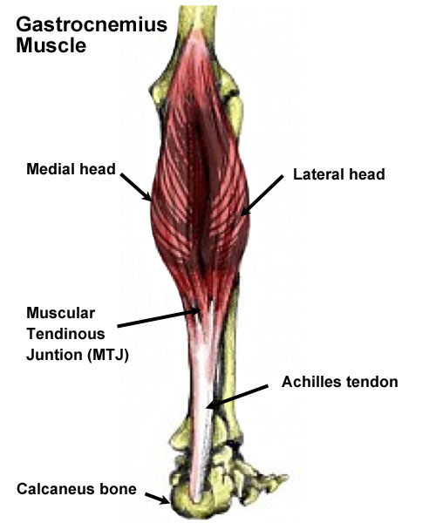
The “calf”
Made up of 2 muscles
Gastrocnemius
Large muscle we commonly think of as the “calf” muscle
Soleus
Very thin muscle that lies under the “gastroc”
Provides the ability to walk
Contract when you go up on your toes
This motion is called plantarflexion

Slide 4
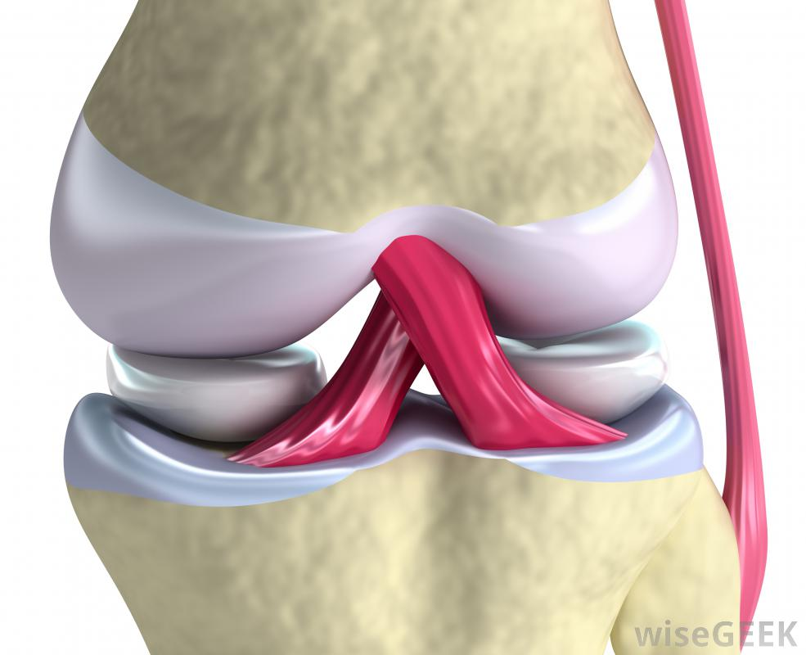
Ligaments
Connect BONE TO BONE
Provide stability
Fibrous tissue
Think ACL
Prevents the femur from shifting anteriorly on the tibia

Slide 5
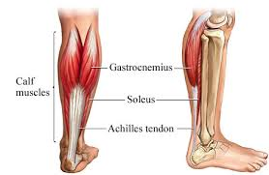
Tendons
Connects MUSCLE TO BONE
Fibrous tissue, that doesn’t stretch well
Think Achillies
Connects the Soleus and Gastrocnemius to the Calcaneus (heel bone)

Slide 6
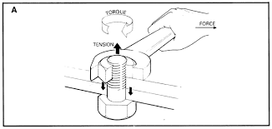
Torque
A measurement of how much force is acting on an object to cause it to rotate
Think of the body your joints are required to rotate around the axis to be able to perform the function you need
Your hips must change lots of directions just to be able to walk…

Slide 7
Power
Expression of energy over time. The push or pull that you place on an object that results in a change in the object or another object
Kicking the ball
The ball is kicked softly
The ball is kicked with all of your might

Slide 8
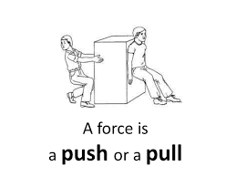
Force
The end result of the push or pull that you place on an object that results in a change in the object or another object
Think of if we kick the ball, the ball moves
If we kick the ball softly, then it doesn’t make it across the floor
If we kick the ball hard enough the ball goes all the way across the field

Slide 9
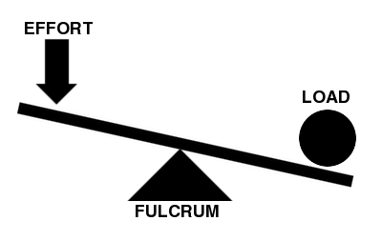
Levers
The part that assist moving a heavy or firmly fixed load with one end when pressure is applied to the other
To pry a door open we use a crow bar
To flex our arm, we use the lever know as our elbow. If we place a weight in our hand, its harder to flex the elbow
What are other levers we see in the body?

Slide 10
5 Components of Fitness
CARDIOVASCULAR ENDURANCE
Cardio = dealing with the heart
Vascular = dealing with blood/venous system
Your body’s ability to keep up with exercises like running, jogging, swimming, cycling etc…
Heart and lungs fuel the body with oxygen needed by muscles, ensuring that they have oxygen needed for the work they are doing

Slide 11
5 Components of Fitness
MUSCULAR STRENGTH
Muscular = muscle
Strength = strong or how much
The POWER that helps you lift/carry heavy objects
Your body wouldn't’t be able to walk without strength
To get stronger you should lift high weight, low number of times (High weight at low repetitions)

Slide 12
5 Components of Fitness
MUSCULAR ENDURANCE
Muscular = muscle
Endurance = length of time
The ability of your muscles to perform an activity over a period of time…think carrying your book bag
To increase your muscular endurance you should lift lower than your maximum weight a high number of times (low weight at high repetition)
20-25 defines high repetition

Slide 13
5 Components of Fitness
FLEXIBILTY
Your body’s ability to stretch and move
Most important part of the components
Most overlooked component of physical fitness
Easiest component to improve
But takes discipline
Lack of flexibility causes back pain, which causes all other body pain
Especially in teenagers

Slide 14
5 Components of Fitness
BODY FAT COMPOSITION
Refers to the amount of fat on your body
Lean Mass is mass that does not contain fat
This is on a scale depending on your gender
The average man tends to have 18-24% of body fat
The average woman tends to have 25-31% body fat
Various ways of testing
Some are more reliable than others

Slide 15
5 Components of Fitness
How do we test each of these in PE class?
Cardiovascular Endurance
Muscular Strength
Muscular Endurance
Body Fat Composition
Flexibility

Slide 16
Antagonist Muscles
Muscles that act as opposites
They occur in pairs
If one muscle is contacting then the other MUST be relaxing

Slide 17
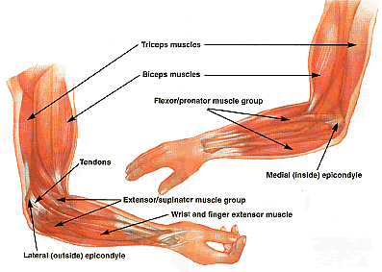
Antagonist Muscles
Examples include:
Biceps and Triceps
Abdominals and Back musculature
Quadriceps and Hamstrings
Others?

