Slide 1
Obesity in Childhood
About 1/3 of American children
are overweight or obese.

Slide 2
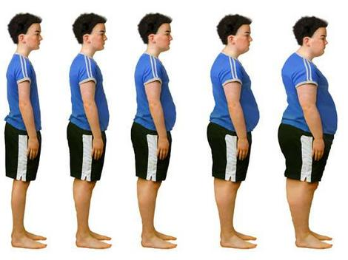
The childhood obesity epidemic is increasing . . .

Slide 3
Obesity Trends* Among U.S. Adults BRFSS, 1990, 1999, 2009
(*BMI ≥30, or about 30 lbs. overweight for 5’4” person)
1990
1999
2009
No Data <10% 10%–14% 15%–19% 20%–24% 25%–29% ≥30%

Slide 4
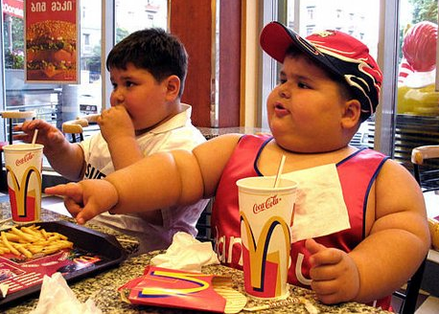
Childhood obesity is doubling every couple of decades . . .

Slide 5
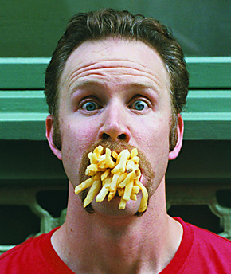
Americans spend $150 BILLION at
fast food restaurants each year.

Slide 6
Effects of Childhood Obesity
Type-2 Diabetes
Metabolic Syndrome
High Blood Pressure
High Cholesterol
Asthma
Early Puberty
Sleep Disorders
Low self-esteem

Slide 7
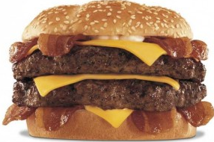
“In essence, the fat taste is just a habit, created by conditioning. All too often, high-fat foods or sweets are held out as rewards to children for ‘good behavior’.”
Dr. Leann Birch at the University of Illinois Child Development Laboratory has found that in Western countries, young children are conditioned or taught to like animal-based foods.

Slide 8
“For example, how many times have you heard parents say, ‘You can have your ice cream if you eat your spinach?’ They quickly assume that if ice cream is the reward, then spinach must be the punishment.
The late Charles Attwood, MD, Low-Fat Prescription for Kids

Slide 9
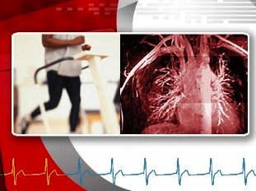
Cardiovascular Disease
37% of Americans have cardiovascular disease (81.1 million)
Major risk factors:
High blood cholesterol
Type II diabetes
High blood pressure
Overweight and obesity
Physical inactivity
Tobacco use
Also heredity and sex (being male)

Slide 10
High Blood Pressure
34% of Americans have high blood pressure (74.5 million)
High blood pressure is a major risk for
Heart (cardiovascular) disease
Stroke
Congestive heart failure
Kidney disease
Dietary factors that increase risk of high blood pressure:
Excessive sodium intake
Insufficient potassium intake
Overweight and obesity
Excessive alcohol consumption

Slide 11
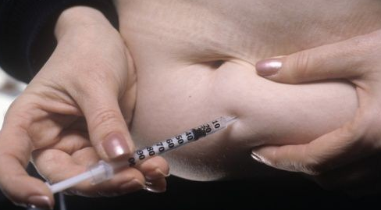
Diabetes
11% of Americans have diabetes (24 million)
35% of Americans have pre-diabetes (78 million)
The vast majority of Type II diabetes cases are linked to
poor diet
physical inactivity
overweight / obesity

Slide 12
Cancer
Dietary factors are associated with the risk following cancers:
Breast
Endometrial
Colon
Kidney
Mouth
Pharynx
Larynx
Esophagus
Approximately 41% of Americans will be diagnosed with cancer in their lifetime (almost 1 out of 2 people)

Slide 13
Osteoporosis
Even though these fractures happened in old people, 90% of bone density (thickness) is developed during the teen years.
Adequate nutrition and regular physical activity are important factors in achieving and maintaining optimal bone mass.
50% of women and 25% of men will have an osteoporosis-related fracture in their lifetime.

